Slide 1

EL221 Digital Logic Design
LECTURE 12
PULSE Waveforms Operations
Engr.Hammad Munami

Slide 2
Review
The output of an AND gate is HIGH only when all inputs are HIGH at the same time.
The output of an OR gate is HIGH only when at least one of its inputs is HIGH.
The output of a NAND gate is LOW only when all inputs are HIGH at the same time.
The output of a NOR gate is LOW only when at least one of its inputs is HIGH.
Engr.Hammad Munami

Slide 3
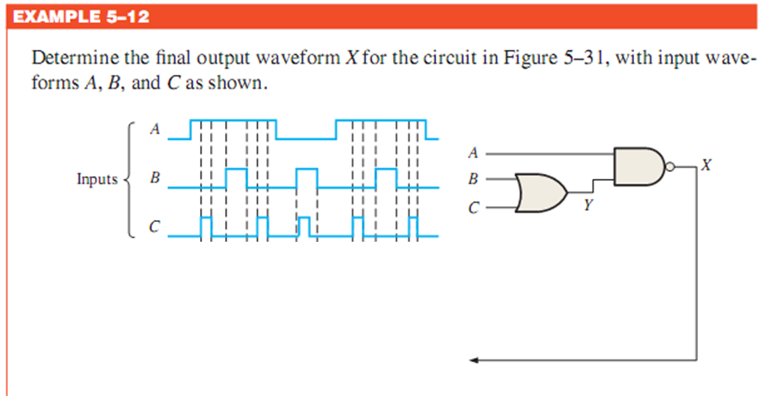
Engr.Hammad Munami

Slide 4
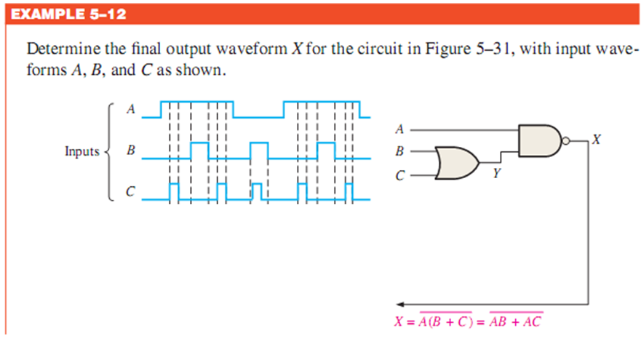
Engr.Hammad Munami

Slide 5
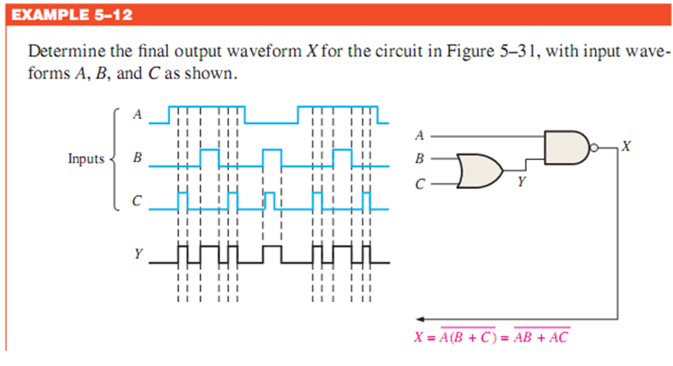
Engr.Hammad Munami

Slide 6
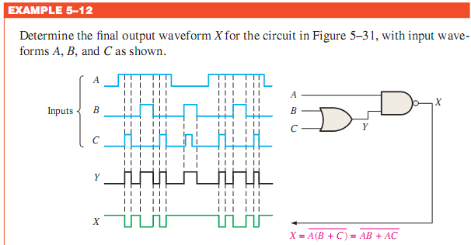
Engr.Hammad Munami

Slide 7
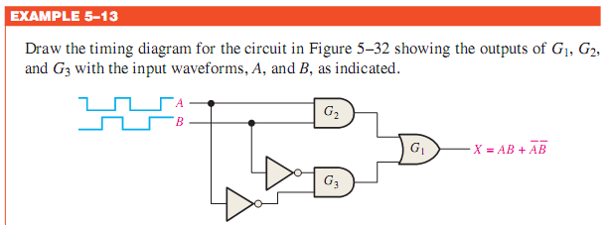
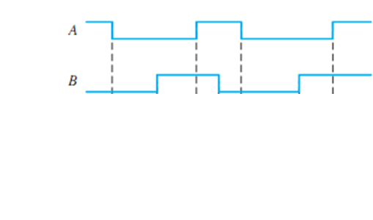
Engr.Hammad Munami

Slide 8
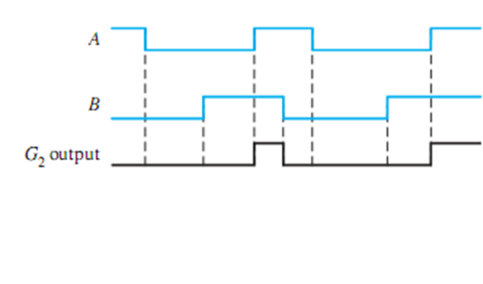
Engr.Hammad Munami

Slide 9
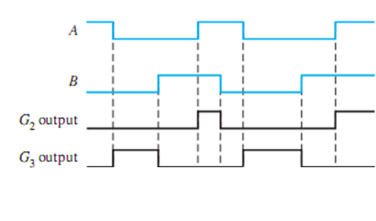
Engr.Hammad Munami

Slide 10
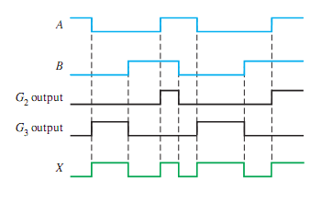
Engr.Hammad Munami

Slide 11
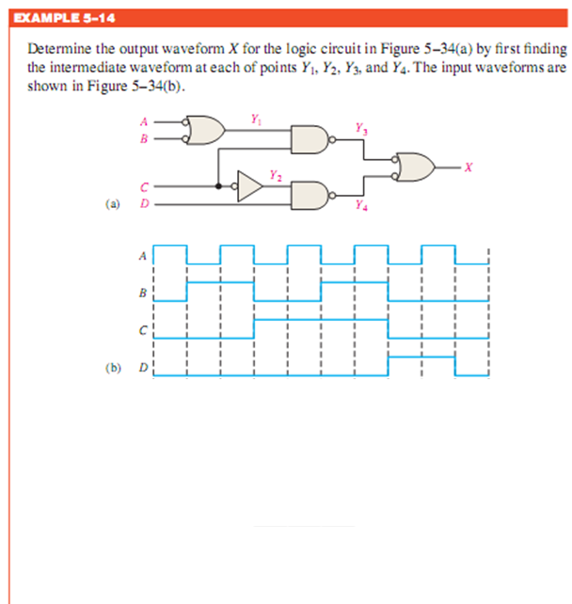
Engr.Hammad Munami

Slide 12
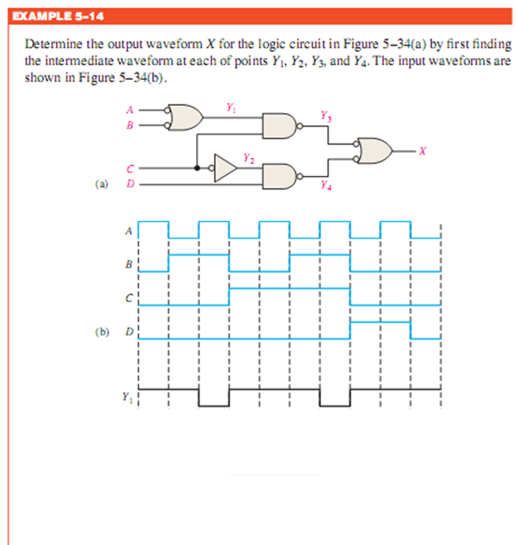
Engr.Hammad Munami

Slide 13
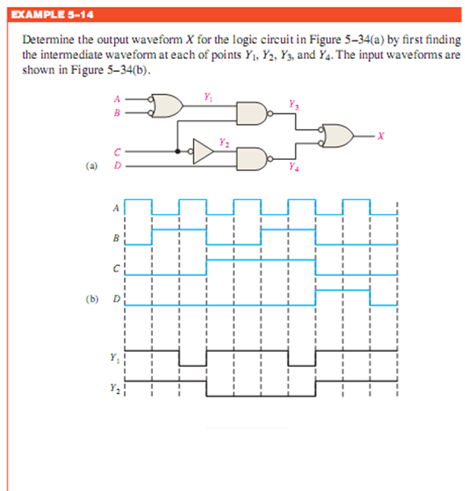
Engr.Hammad Munami

Slide 14
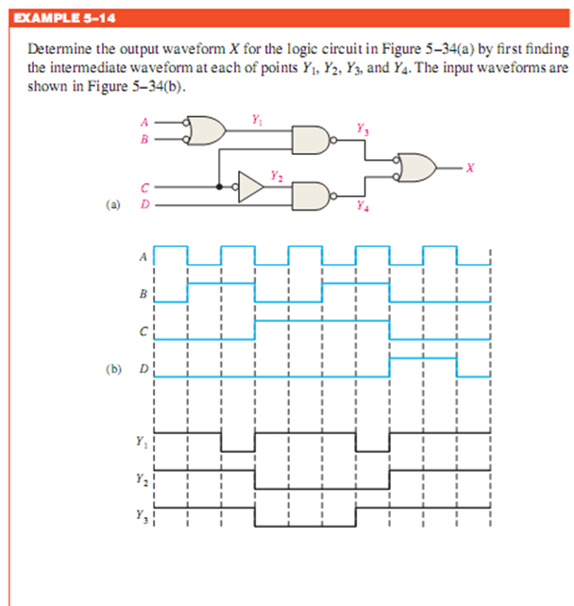
Engr.Hammad Munami

Slide 15
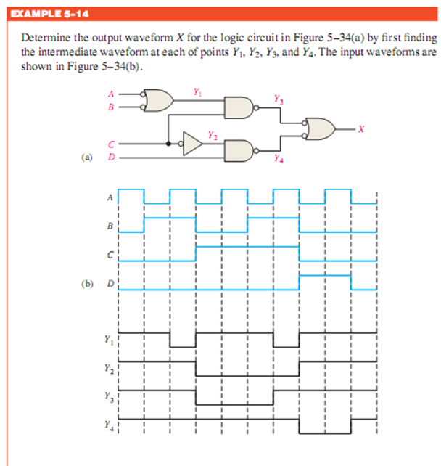
Engr.Hammad Munami

Slide 16
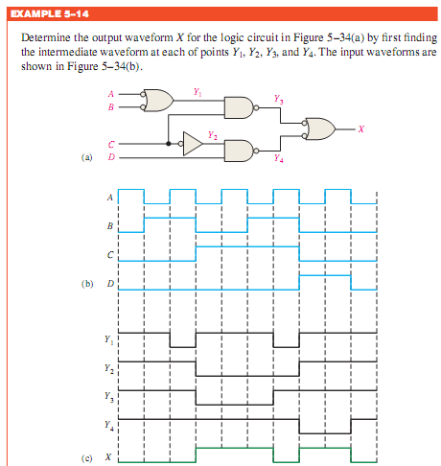
Engr.Hammad Munami

Slide 17
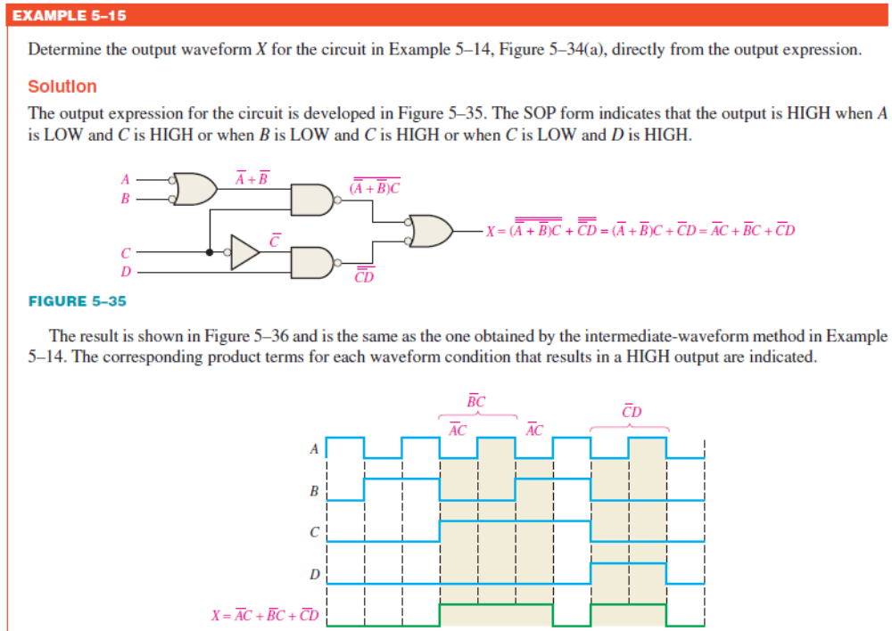
DIY
Engr.Hammad Munami

